Slide 1


Writing High Performance AI Agents in Python: Insights from building Modulo

Slide 2

whois
Software Engineer and Team Lead with over 13 years of experience building performant and scalable distributed systems at Google, VMware, Arista Networks and SAP
M.S. in CS from Dartmouth College
BIT Mesra alumni
Founder and CEO of Modulo

Slide 3
What is Modulo?
The design and development of Modulo was inspired by a number of problems that are as yet unsolved!
"Analyzing Bug Reports is time consuming"
Parse through logs and artifacts
Read through 30+ comments
Only to find the bug is not actionable due to log rollover, or is not reproducible.
"Monitoring tools produce too many spurious alerts"
Should I be worried about this alert?
Did a recent change cause this issue?
"LLMs can solve all the problems"
But its hard to validate LLM generated bug fixes.
An average bug report with over 1 billion tokens is too much for frontier models.

Slide 4

Challenges with fixing bugs using frontier AI
Over reliance on LLMs is a problem
LLM calls are slow! And every tool that uses them becomes slow.
A lot of existing solutions such as mutation testing are ignored and under valued.
Existing tools focus on converging on ONE correct fix for a problem (high precision).
If that solution doesn't work developers have to effectively guide the tool to try a specific approach until something works.
After a few iterations, context summarization etc, do developers even know what context the LLM is working with?

Slide 5

How is Modulo different?
Automated Fixes & Validation
Real-Time Monitoring
Handles Large Data
Data Pipeline
Multi-Agent Reproduction

Slide 6

Building LLM applications for speed
In this talk we will explore design patterns for building LLM-based applications that have
1
2
3
Higher token throughput and low time to first token
Optimal system architectures for high QPS
… all without sacrificing response accuracy.

Slide 7

Why Performance Matters
Building high-performance LLM applications requires strategic thinking. This talk shares practical strategies from developing a coding agent that fixes bugs.
User Experience
Cost Efficiency
Scalability
Fast responses keep users engaged and satisfied
Optimized systems reduce operational expenses
Performance enables growth without bottlenecks

Slide 8

Not Covered in this Talk
Strategies for improving accuracy and correctness
Multi-agent co-operation and orchestration
… These are all separate talks in themselves …

Slide 9

Design Patterns for Higher Token Throughput
When users request services—image generation, internet searches, or alerting agents—developers must consider critical factors:
Input Analysis
Output Requirements
How many documents need processing? What's the total token count?
How many output tokens must be delivered to the user?
Work Breakdown
Response Time
Can the work be broken into stages for better efficiency?
Does the user expect an instant response or can processing be asynchronous?

Slide 10

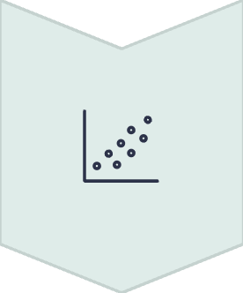


Classical Patterns Apply
When you spot multiple input documents, staged processing, and chunking possibilities, proven distributed system patterns become relevant:
Scatter Gather
Hadoop-style parallel processing
Pipelining
Microservices working independently
High Parallelism
Maximize concurrent operations
But before you dive into implementation, always start with the math behind working with LLMs.

Slide 11
Reasoning about user performance expectations
Start with setting realistic expectations before building any feature. For a given function, how soon will an impatient user expect a response?
Chat Mode
Deep Research Mode
Quick responses for simple queries (Time to First Token is key)
Extended processing for complex tasks (Token Throughput is key)
An Example:
1
2
3
Initial Research
Section Generation
Final Assembly
30 seconds upfront to gather sources and create a plan
10 seconds per section to process tokens and generate output for each section independently
Combine all independent sections and reword into a cohesive narrative.

Slide 12
Real-World Example - Find relevant files for a bug
While building Modulo, the single biggest bottleneck was the LLM API. For 50 files, a naive approach sends one gigantic prompt and waits for tens of thousands of output tokens.
At 50 output tokens/sec, 30,000 tokens takes 600+ seconds (10 minutes).
What we did:
Each file is decomposed into one or more chunks.
LLM call for each chunk is done in a separate thread.
Using 16 parallel LLM calls on a standard VM with 16 vCPUs gives us:
16 × 50 = 800 output tokens/sec which means the time is reduced to 40 seconds (from 10 minutes)!!
This pattern works particularly well for "find a needle in a haystack" type of problems - such as root causing and generating fixes for bugs.

Slide 13
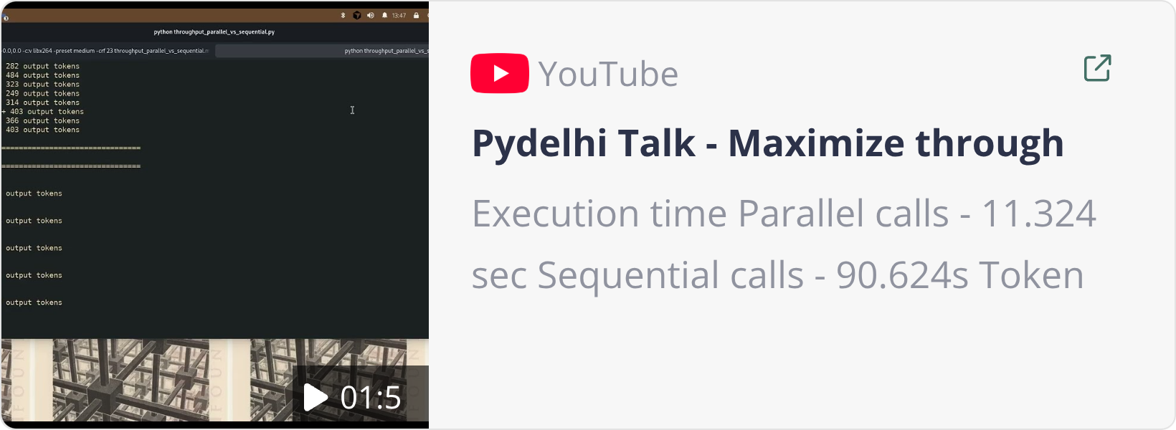
Demo - maximizing throughput with chunking
Execution time
Parallel calls - 11.324 sec
Sequential calls - 90.624s
Token throughput
Parallel calls - 6035 tokens/s
Sequential calls - 751 tokens/s
Code for this demo is here

Slide 14
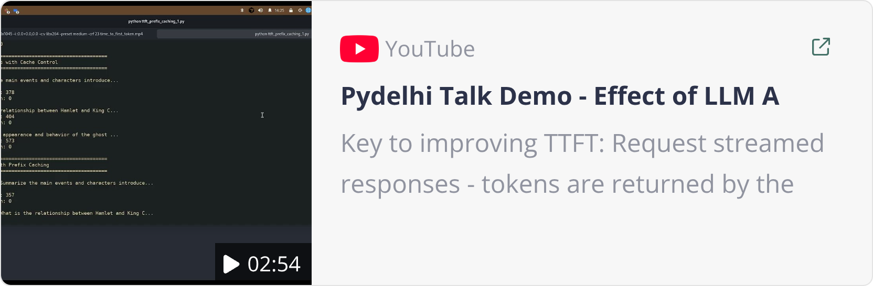
Demo - improving time to first token
Key to improving TTFT:
Request streamed responses - tokens are returned by the LLM as soon as they are generated, in multiple responses which need to be assembled together.
Request prefix caching to be enabled.
TTFT = 2.4s with streaming v/s 13 seconds without streaming.
Note that the throughput may get worse, due to the fact that we have to assemble multiple responses.
No streaming - throughput 486 tok/s
streaming - throughput 244 tok/s
Code for this demo is here

Slide 15
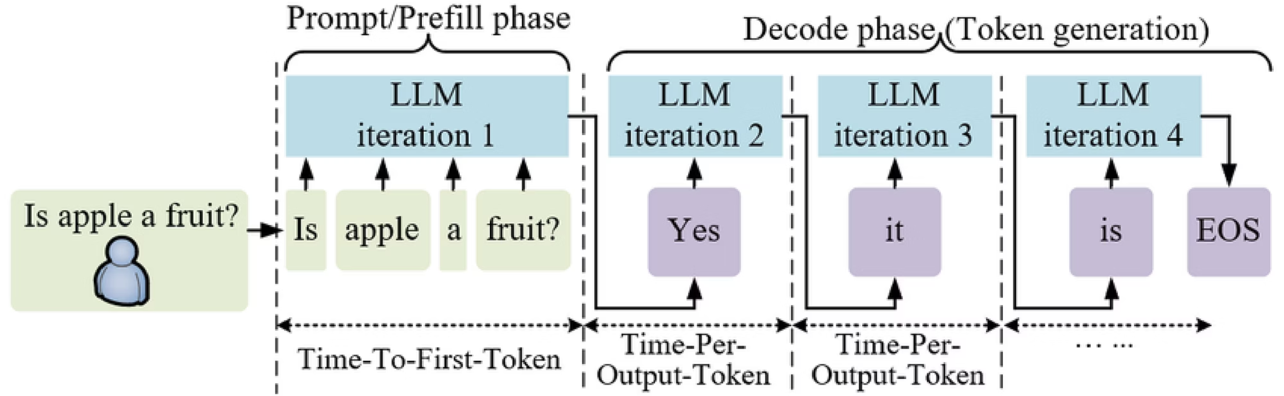
Wait but Why?- A Case Study [TTFT]
Time to first token is directly proportional to the number of input tokens.
First output token is generated immediately after the prefill phase. The algorithm to generate subsequent output tokens is separate and is referred to as "decode phase".Based on benchmarks it was found that for Llama-3.1-70b each input token adds 0.05ms to the time to first token.
For 20,000 input tokens, one LLM call would mean - 0.05 × 100 × 200 = 1000 ms = 1s.

Slide 16
Wait but Why? - GPT-4 Turbo [Throughput]
To measure the impact of number of output tokens, we have to see the metric "inter-token latency" or "time per output token".This metric only counts the latency between each token in the decode phase, which means it does not depend on the number of input tokens. For Llama-3.1-70b, with 2000 output tokens, ITL was measured by NVIDIA at 30ms.This means generating each output token takes 30ms. Generating 2000 output tokens would mean - 2000 × 30 ms = 60 seconds, or 1 minute.

Slide 17

Output tokens > Input tokens
Total time taken = ~30ms * (Number of Output tokens) + 0.0.05ms * (Number of Input Tokens)
Performance impact of the number of output tokens overshadows the number of input tokens.

Slide 18
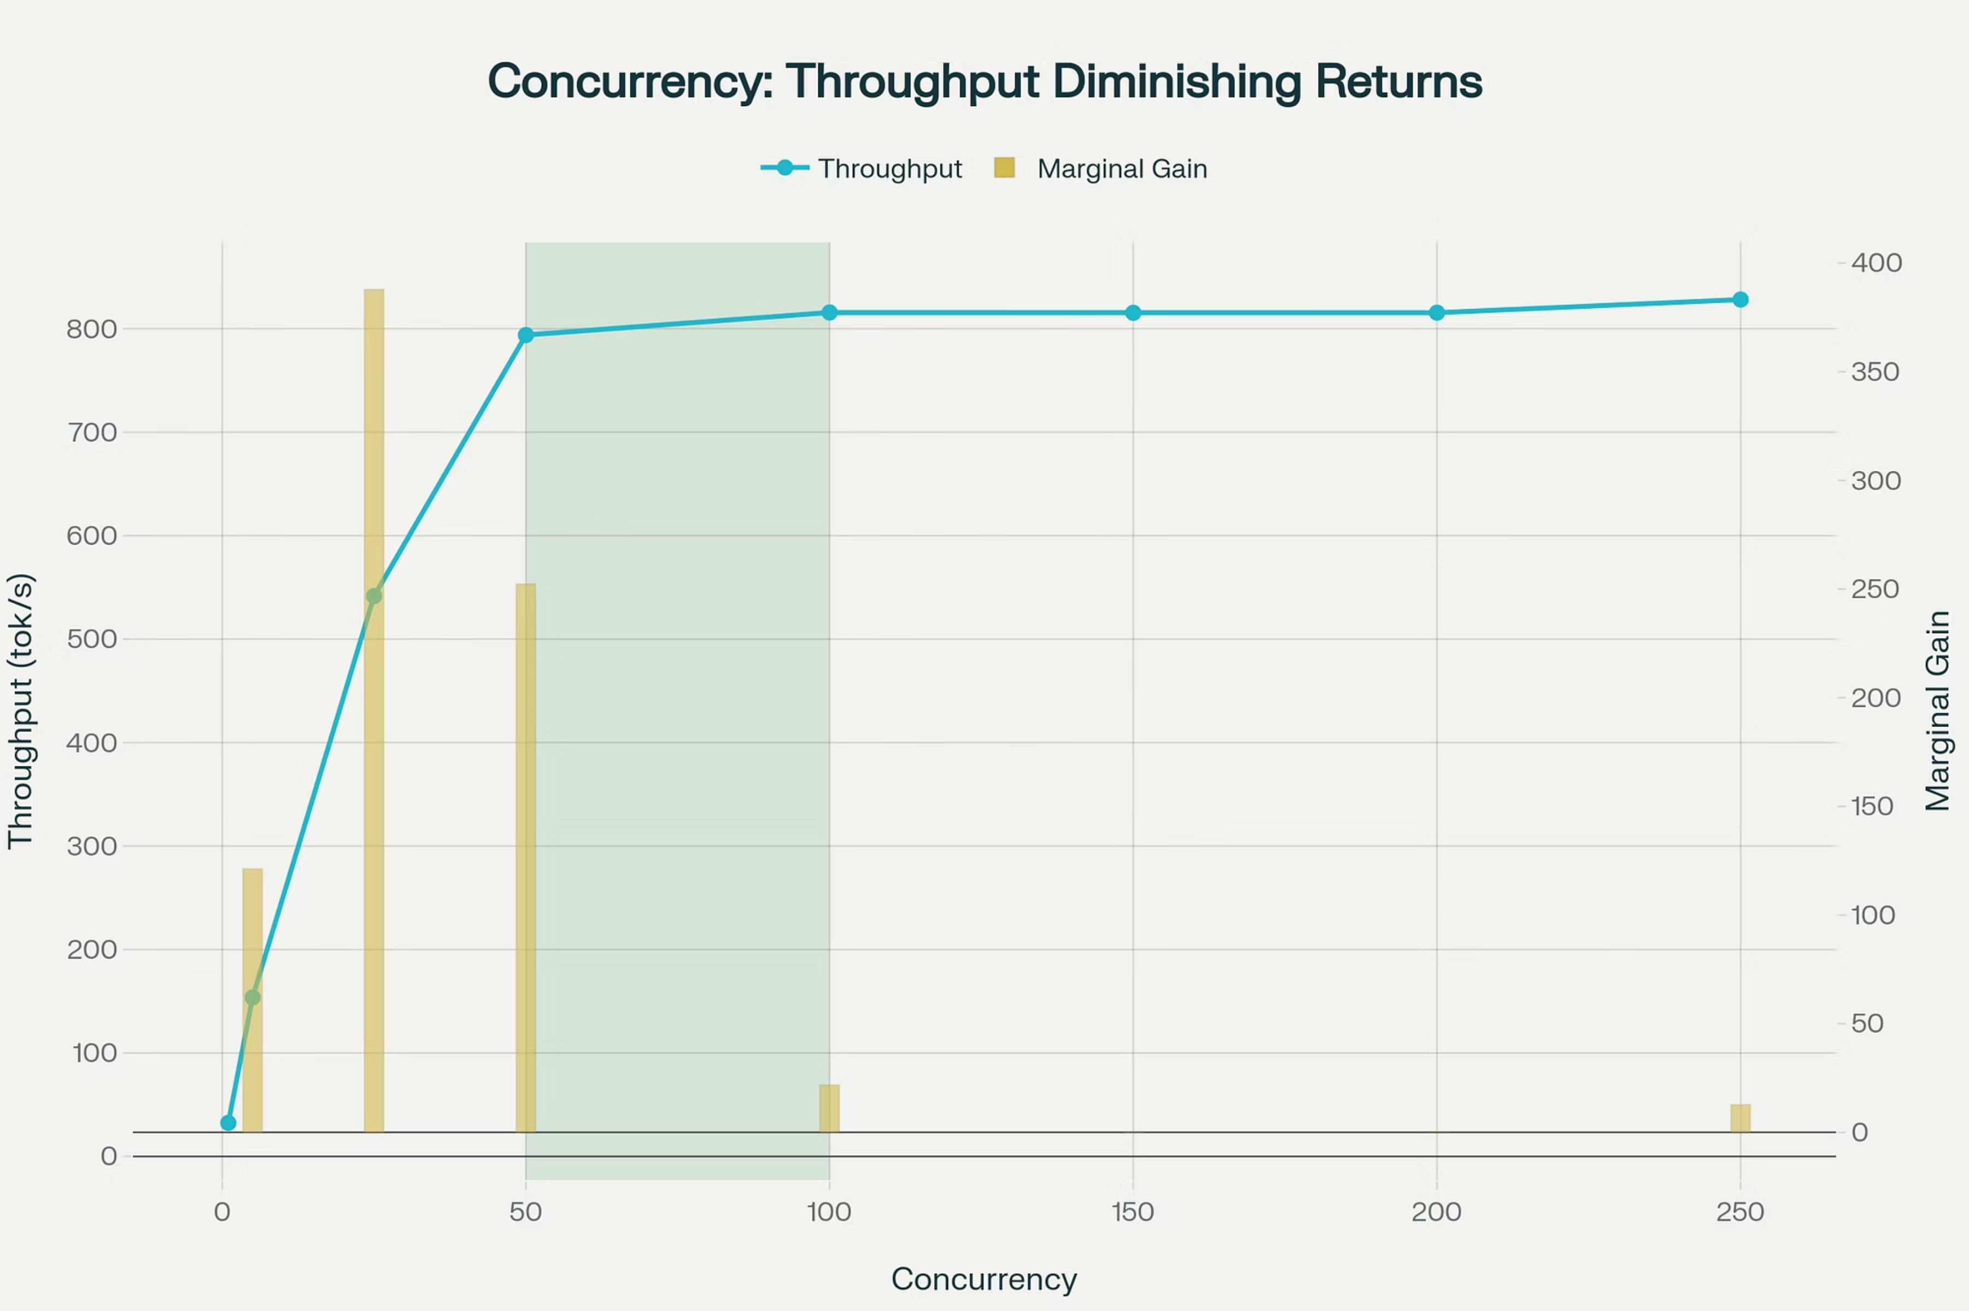
Do performance wins from concurrency last forever?
Unfortunately, no. As this graph based on data from NVIDIA shows, as concurrency increases, throughput gains plateau.

Slide 19
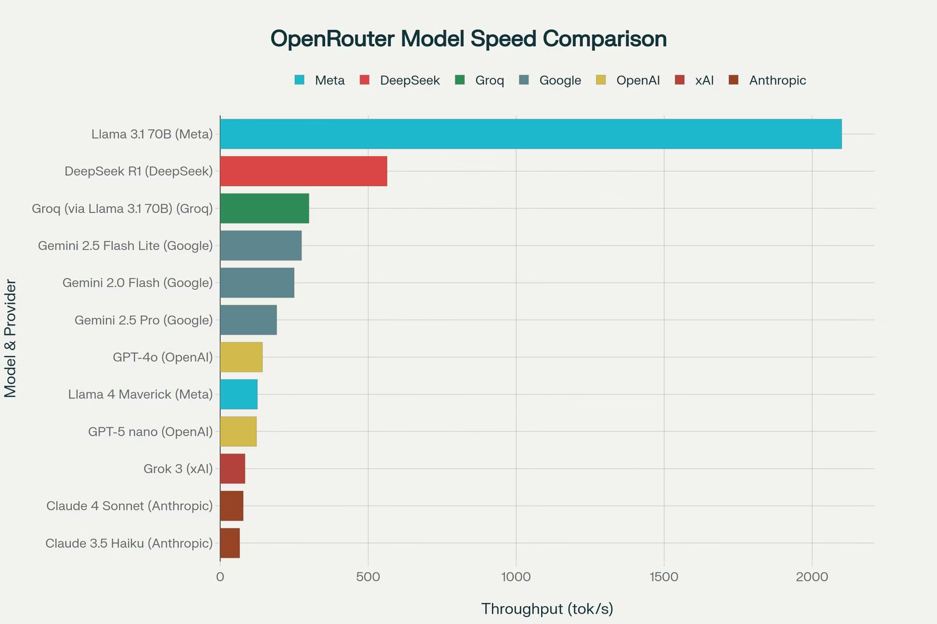
Know your LLM model's output tokens/sec

Slide 20
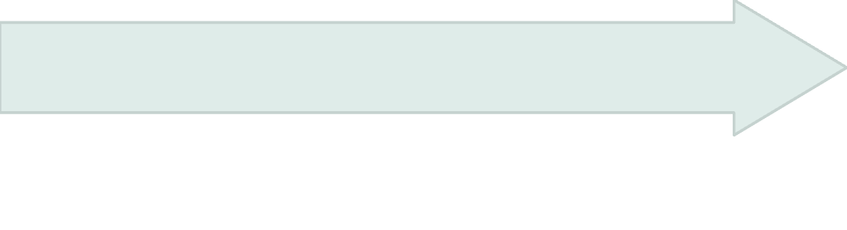

Jump Through Stages with Microservices
Transitioning to microservices boosts performance via parallelism and asynchronous processing.
Event Queue Architecture
Parallel Execution
RabbitMQ enables independent worker processing
Python Asyncio
Concurrent file/network ops, reducing I/O wait
Async handling for LLM API calls, preventing blocks
Benefits
Drawbacks
6× faster bug fixes
Higher complexity
Concurrent job processing
Increased monitoring
Decoupled producers and consumers
Django async ORM limitations

Slide 21

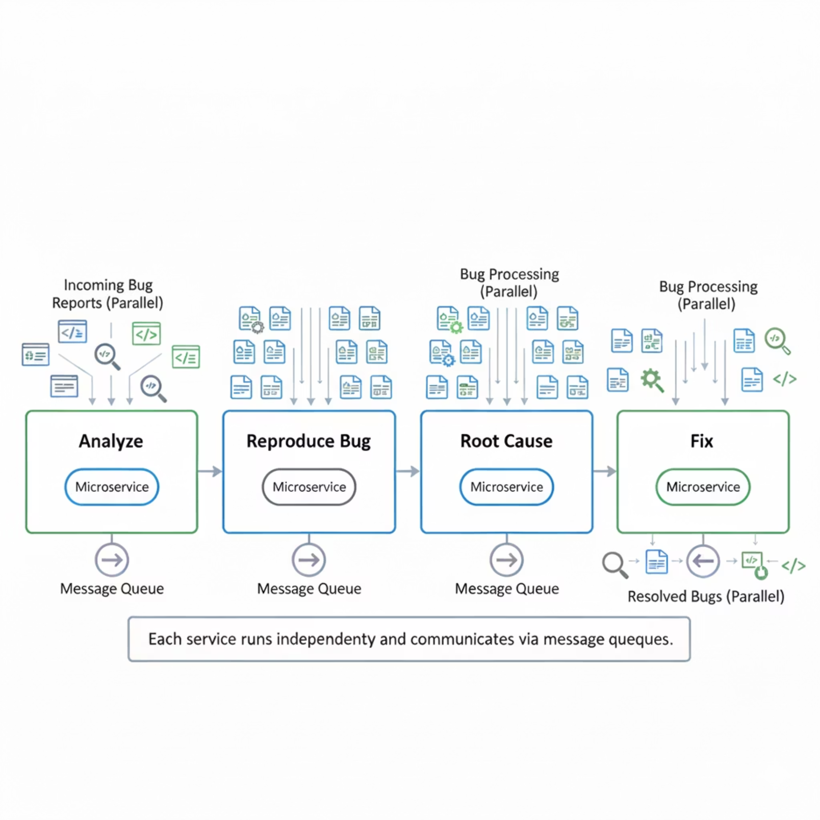
Modulo's bug processing pipeline allows stages to operate independently for incoming bugs.
Analysis
Parse and compress bug report and artifacts
Reproduce Bug
Reproduce bug and write test case
Root Cause
Identify root cause
Fix
Generate fix
Validate
Validate fix with reproduction

Slide 22
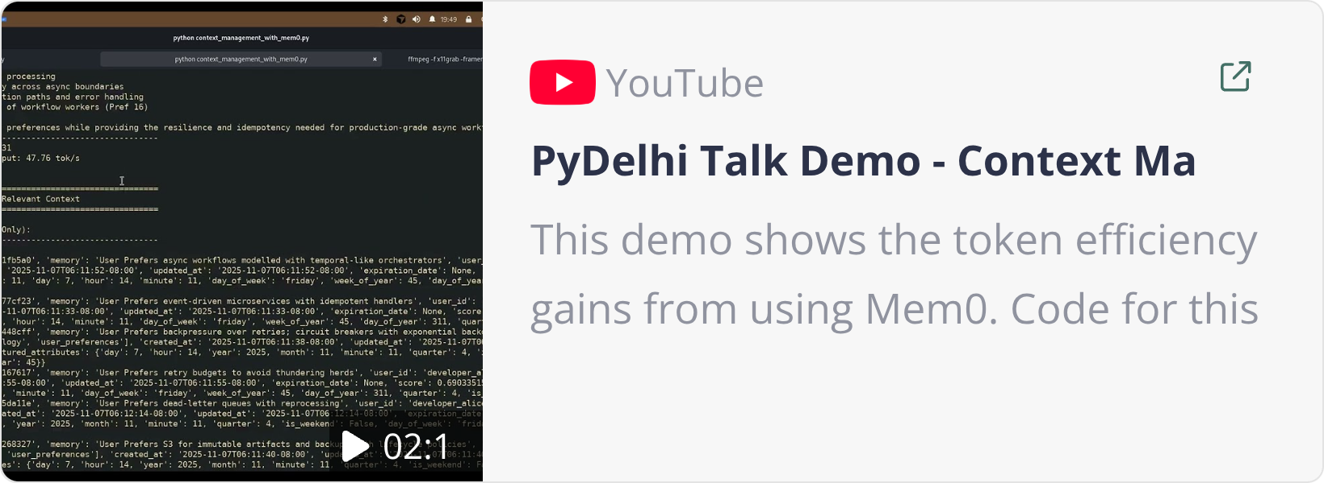
Context Management with Mem0
Mem0 processes a prompt to extract relevant facts from previous conversation history.
Its internal architecture combines a vector database (for memory embeddings) and a graph database (for memory relationships).
Similar to RAG, Mem0 fetches only pertinent facts, avoiding the need to send an entire knowledge base.

Slide 23
Know Your Workload
1
Understand dependencies, parallelization, and atomicity requirements.
Tokens are the key
2
Reduce token usage for lower cost and better performance; use cost-effective models for non-critical tasks.
Embrace Parallelism
3
Leverage parallel processing for LLM applications.
Use Flexible Architectures
4
Microservices offer independent scaling, fault isolation, and pipelining.
Expect Failures
5
Implement retries universally to handle unpredictable behavior.

Slide 24


